Slide 1


Lyme Disease: Case Trends, Climate, and Risk Across the U.S.
Daniel zapata
Nashville software school
Notes:
Today, we’re going to be discussing Lyme Disease and exploring case trends, the impact of climate change, and risk levels across the United States.

Slide 2
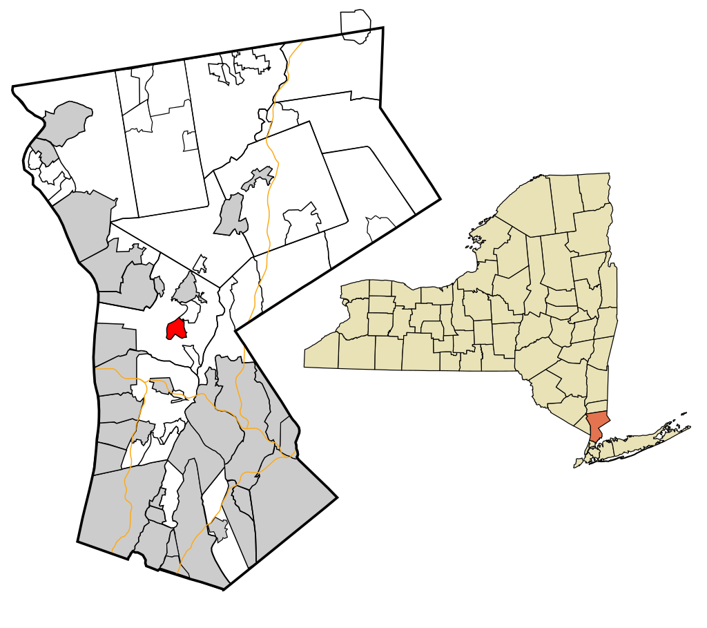
Motivation
01. Grew up in New York
02. Spent time outdoors
03. Road trips across the Northeast
04. Contracted Lyme disease twice
05. Explore risk in Nashville, TN
Notes:
I grew up in New York just 30 miles north of New York City. As a kid, I contracted Lyme disease twice, which we fortunately caught early, so I was able to get treated with no lasting effects. Then I moved down to Nashville in 2012 and remember being told there really wasn’t any Lyme here, but I never looked into it. This project allowed me to dig into the data and investigate whether that claim was actually true or not.

Slide 3




Questions to Explore
How has Lyme disease changed over the past several decades in the United States?
Which states are most affected by Lyme disease and has that changed over time?
Which states have experienced the most significant increase in cases?
Is there a relationship between winter temperatures and case counts?
Does adjusting for population change which states are considered most at risk?
What is the risk of Lyme disease in Tennessee and specifically, Davidson County?
Notes:
Some of the questions I was interested in answering pertained to how Lyme disease has evolved over time, what areas of the country are most affected, what effect (if any) has climate change had on cases, and finally, what my risk looks like living here in Nashville.

Slide 4
Data Sources
Centers for Disease Control and Prevention (CDC)
National Centers for Environmental Information
United States Census Bureau
Case counts by month and year
Case counts by state
Case counts by county
US average monthly temperatures
Regional average temperatures
State average temperatures
US population by year
State populations by year
Tennessee County populations by year
Notes:
To answer these questions I used three main data sources:
The CDC
The National Centers for Environmental Information
And the US Census Bureau
A quick note regarding the case count data per the CDC. Although there is federal guidance, policies and surveillance practices vary by state, which results in limitations in the data. The analysis presented here uses the officially reported surveillance data, which is just one way Lyme cases are tracked. Other methods suggest the actual number of cases may be significantly higher.

Slide 5
Lyme Disease
Bacterial infection spread through the bite of blacklegged (Ixodes) ticks
Typical symptoms include fever, headache, fatigue, and a characteristic skin rash
Treated with antibiotics
Untreated can lead to more severe symptoms
Notes:
So first, I’d like to start off with a quick introduction on Lyme disease. It is a bacterial infection that is spread to people through the bite of blacklegged ticks. Symptoms can include fever, headache, fatigue, and a characteristic skin rash. Lyme disease is highly treatable with antibiotics when caught early, and most patients with later-stage infections respond well to treatment. However, untreated infection could spread to the joints, the heart, and the nervous system.
.

Slide 6
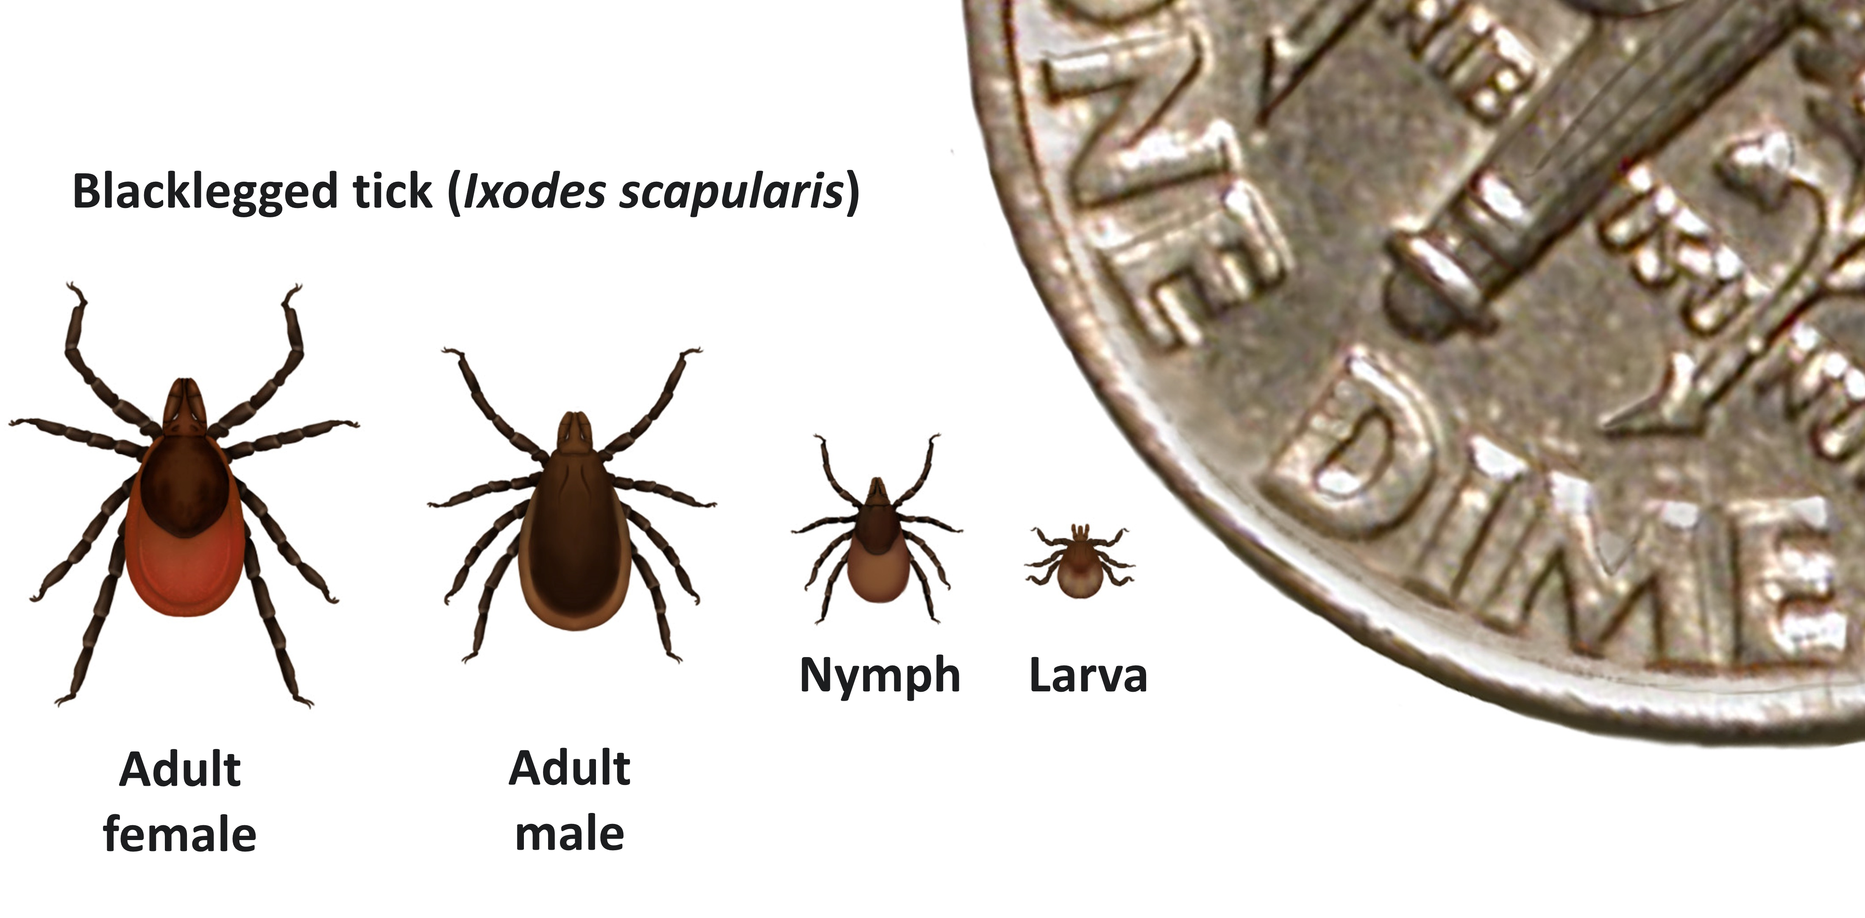
Blacklegged Ticks
Found most commonly in forested areas
2 to 3 year lifespan
4 life stages
Notes:
Next, it’s helpful to understand a little bit about the ticks responsible for transmitting the bacteria that causes Lyme disease. Blacklegged ticks are most commonly found in forested areas of the Northeast, north-central, and mid-Atlantic states, with smaller populations along the Pacific Coast. They typically have a 2 to 3 year life cycle with four stages: egg, larva, nymph, and adult.

Slide 7
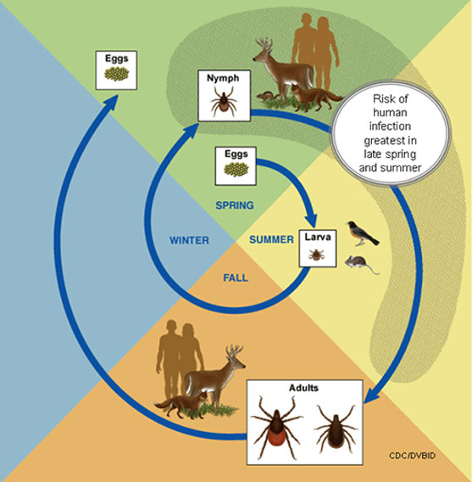
Tick Life Cycle
Require a blood meal
Smaller animals infect the ticks
Attach for at least 24 hours
Notes:
To transition between those life stages or to produce eggs, ticks require a blood meal from a host. It’s during these blood meals the ticks can become infected from animals such as mice. They then can pass it on to their next host when feeding again. Ticks become dormant in freezing temperatures and are most active during warmer months

Slide 8
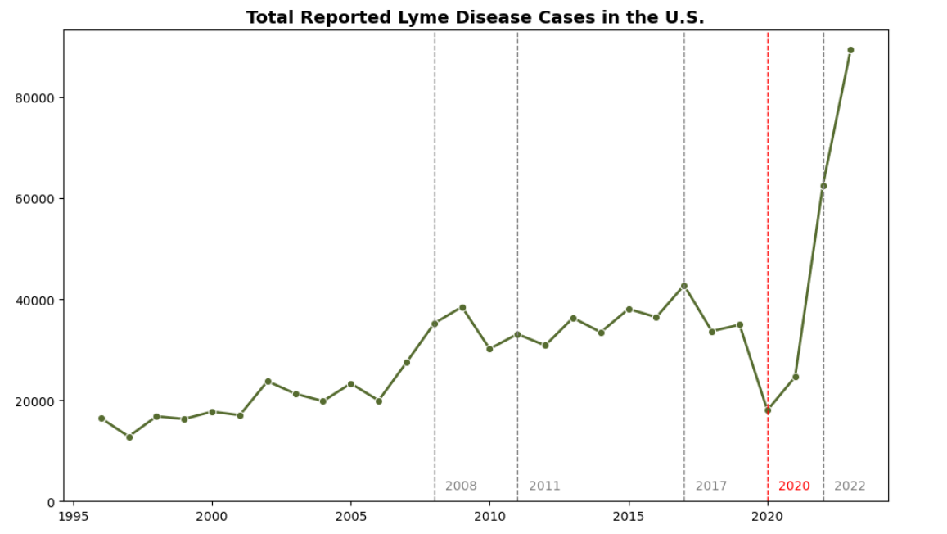
US Case Counts
Notes:
Now that we have some background, we’ll begin looking at case trends across the country. Here we see the total number of cases in the US from 1996 to 2023. The dashed lines are years that the case definition for Lyme disease was modified and the red dashed line in 2020 represents COVID. Around this time we see a dip in reported cases, which can be explained by underreporting due to strained resources in the healthcare system. We see starting in 2022 there is a significant rise in cases. This could be due to the reporting behaviors normalizing after a couple of years of COVID as well as a rule change that made it easier for some states to report cases of Lyme. 2023 saw a jump up to about 89,000 cases.

Slide 9
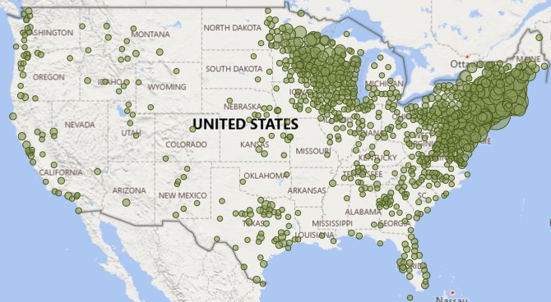
2008
Notes:
We’re going to focus on cases between 2008 and 2023 where we have the most complete data on a state and county level. One thing I want to mention here is that cases are reported based on county of residence, not necessarily county of exposure. This map displays case distribution by county in 2008. Although we see reported cases all across the country, there are some obvious hot zones.

Slide 10
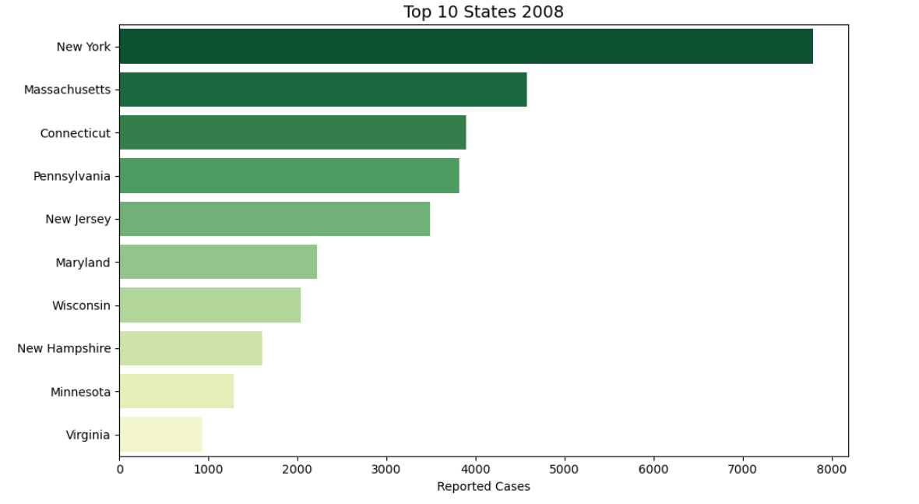
States with the Highest Counts in 2008
Notes:
As expected, based on where blacklegged ticks are most found- states in the northeast and in the north-central region had the highest counts of Lyme

Slide 11
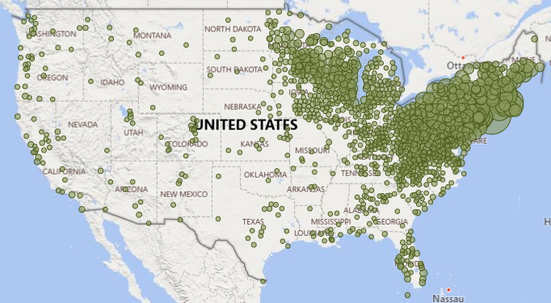
2023
Notes:
Moving forward to 2023- we still see those same hot zones, but now we’re also seeing cases moving towards the Midwest and southeast. Case counts are not only growing, but appear to be expanding geographically.

Slide 12
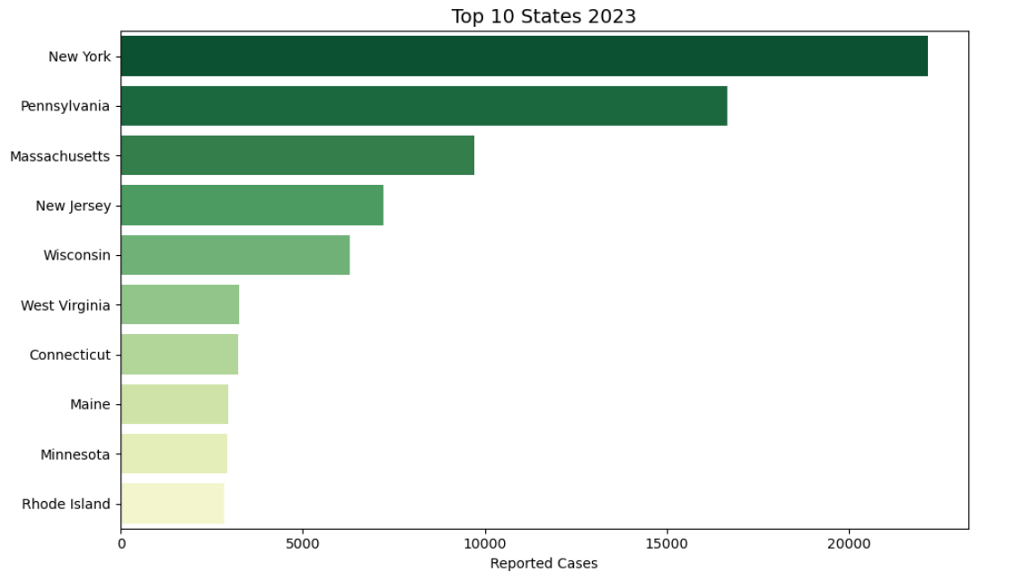
States with the Highest Counts in 2023
Notes:
Once again though, when we look at the highest total case counts we’re seeing similar states and regions as in 2008.

Slide 13
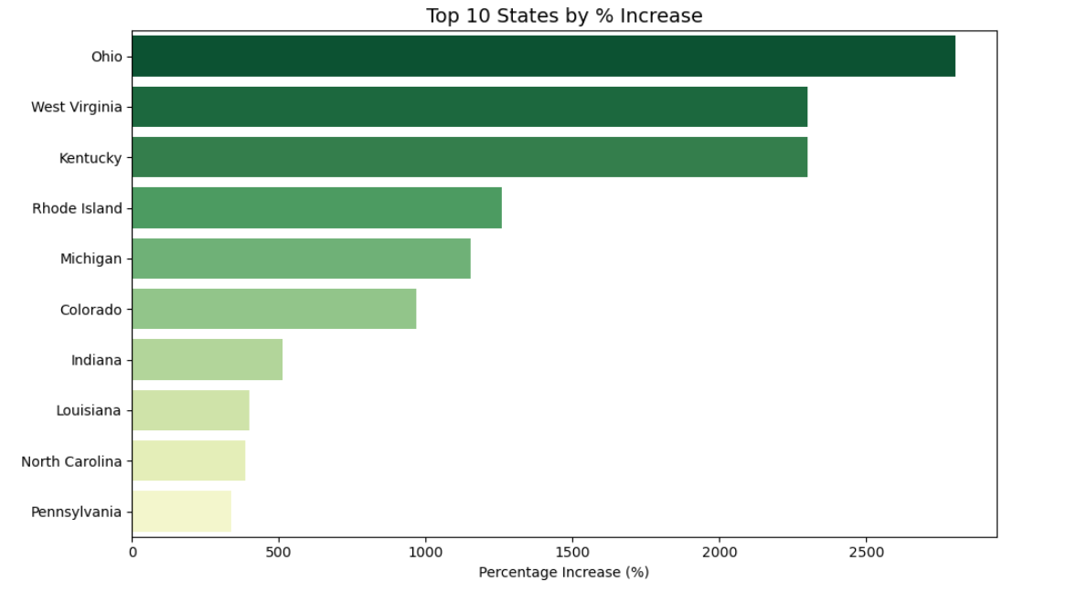
States with the Highest % Increase
Notes:
Nothing too surprising there, however I was interested in which states saw the greatest percentage increase in cases and that’s when we start to see some different names. Ohio tops the list growing from 45 cases in 2008 to a little over 1300 in 2023. West Virginia went from 135 to about 3200.

Slide 14
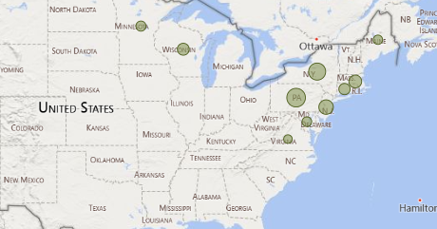
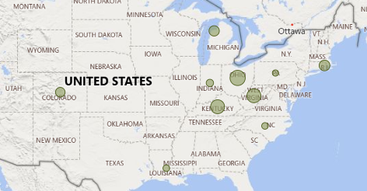
Top 10 States by
Total Cases
Top 10 States by
% Change
Notes:
When we compare total cases vs percentage change, we can really start to see that geographic expansion . This made me curious about what factors could be contributing to the dramatic growth in some of these states. That’s when I decided to concentrate on how climate change may be impacting Lyme disease.

Slide 15
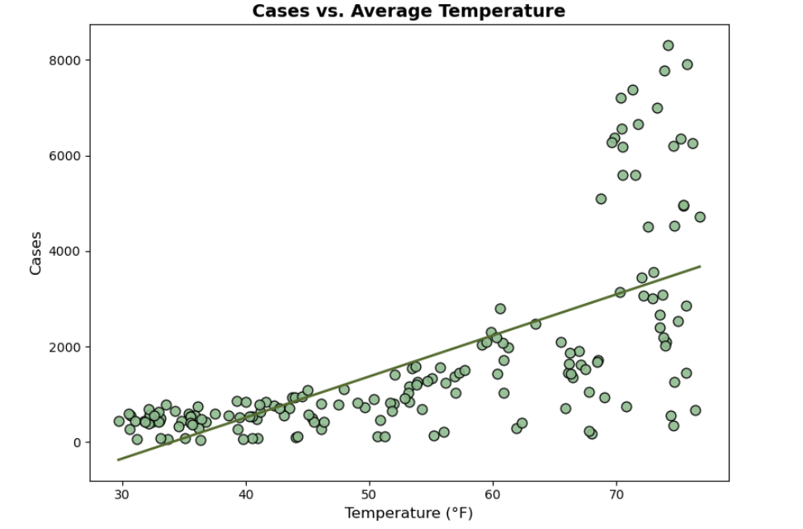
US Cases vs Average Temperature
Notes:
When we look at total cases of Lyme in the US compared to the average temperature of when those cases are reported, we see very clearly a positive relationship. Around the freezing point, there are hardly any cases reported, but as the weather warms up, so do the cases. This makes sense since ticks are more active during warmer temperatures- questing for hosts and potentially contracting and spreading bacteria.

Slide 16
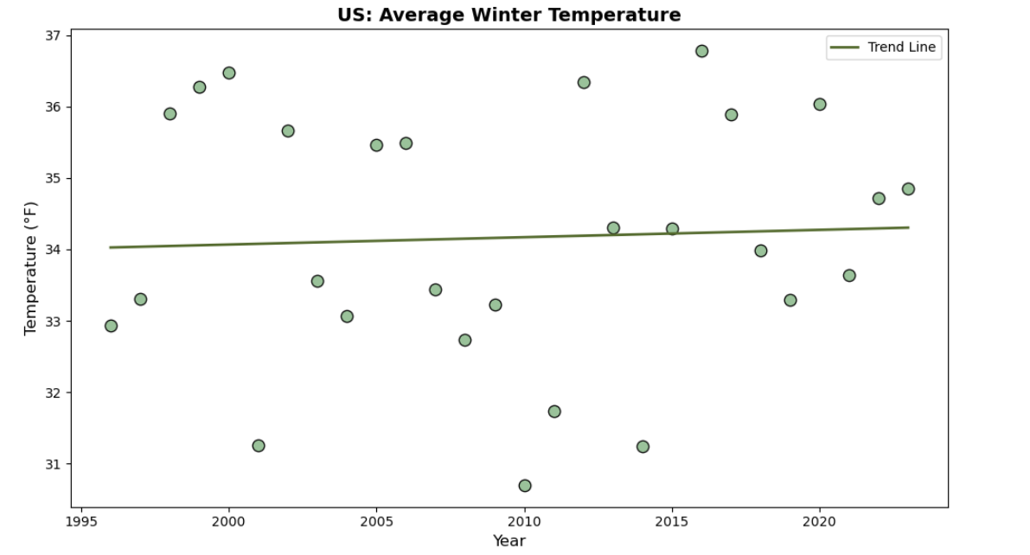
US Average Winter Temperature
Notes:
We know that temperatures are rising globally and from the last graph, we learned a majority of cases are reported when temperatures are higher. I figured tick behavior and Lyme cases wouldn’t vary too much during the warmer months, rather I was interested in what kind of impact winter temperatures have on total cases reported for the year. I designated December, January, and February as “Winter” and found the average temperature across those three months for the US. Here we see evidence of those rising temperatures over time.

Slide 17
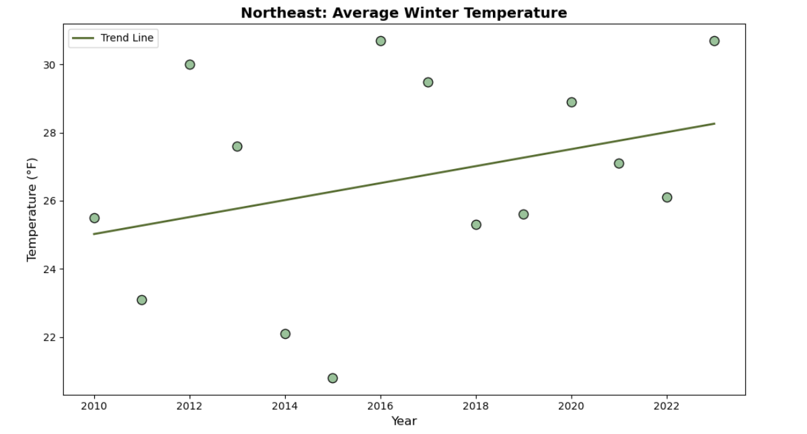
Northeast Average Winter Temperature
Notes:
I first wanted to focus on the Northeast- the region we know has the most Lyme disease. This graph shows that the average winter temperature is rising.

Slide 18
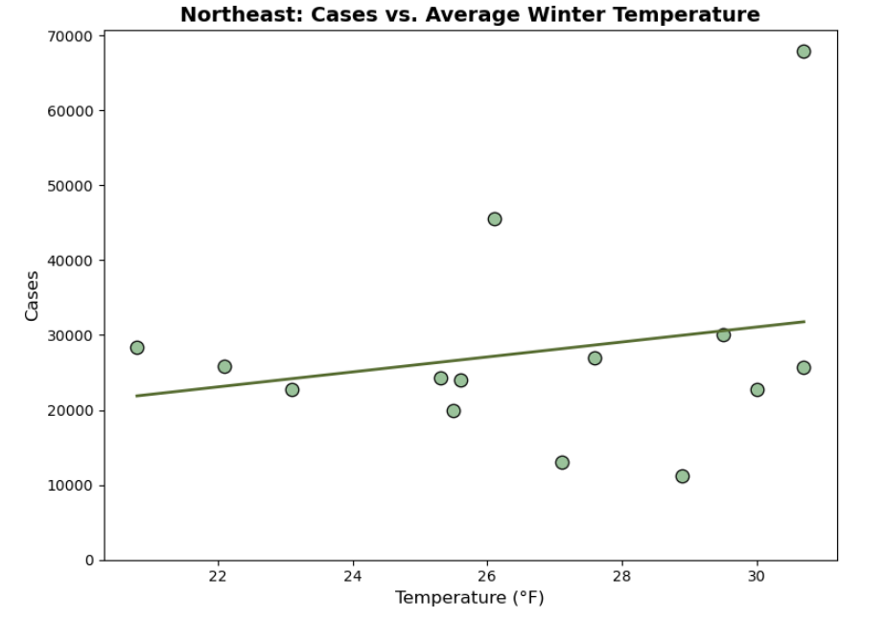
Northeast Cases vs. Average Winter Temperature
Notes:
When we look at cases versus winter temperature- we see just a slight positive relationship and I think this is because if you notice on the graph, temperatures average below freezing. Which means the tick active season has pretty much remained constant.

Slide 19
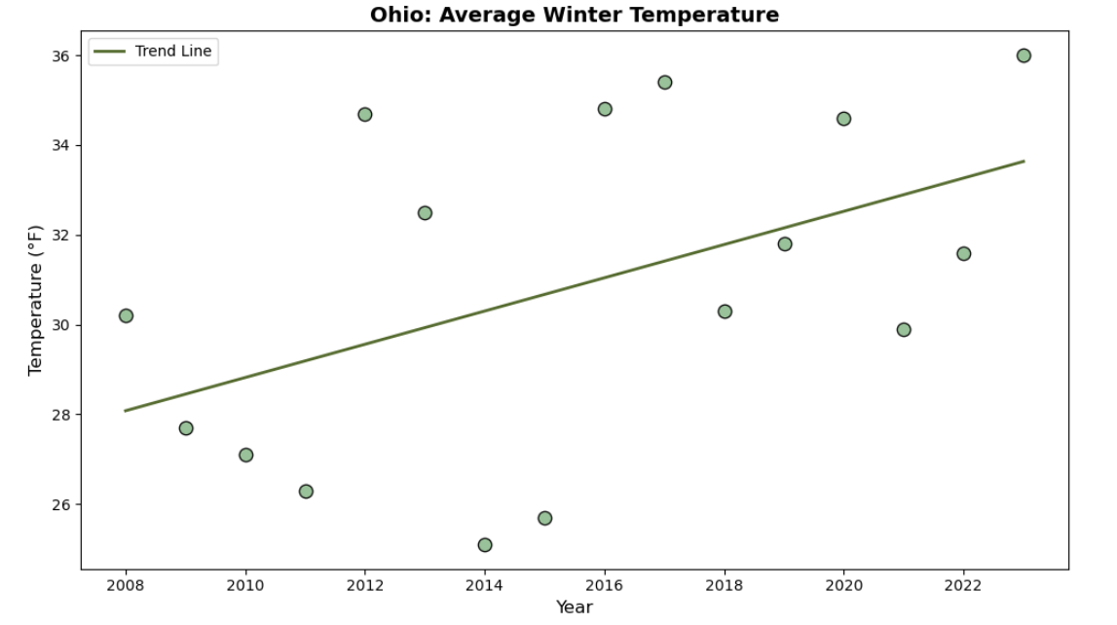
Ohio Average Winter Temperature
Notes:
I then wanted to look at a couple of those states that had the highest percentage change in cases. Here is a graph showing the change in winter temperature in Ohio. Earlier in the time frame average temperatures are below freezing, but over time, it starts hovering around freezing or above.

Slide 20
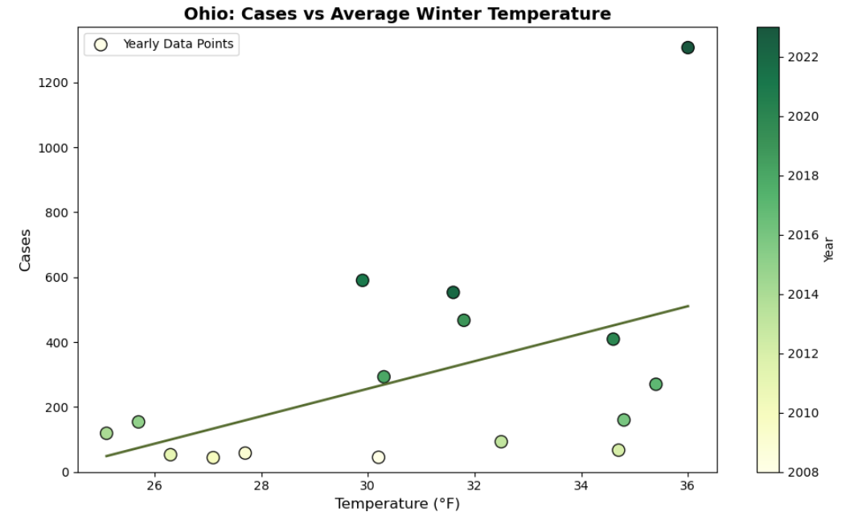
Ohio Cases vs. Average Winter Temperature
Notes:
This graph displays the relationship between winter temperature and case count. We see a stronger relationship here than in the Northeast data- as temperature goes up, so does the total case count for the year- both of which have been on the rise over the past 15 years.

Slide 21
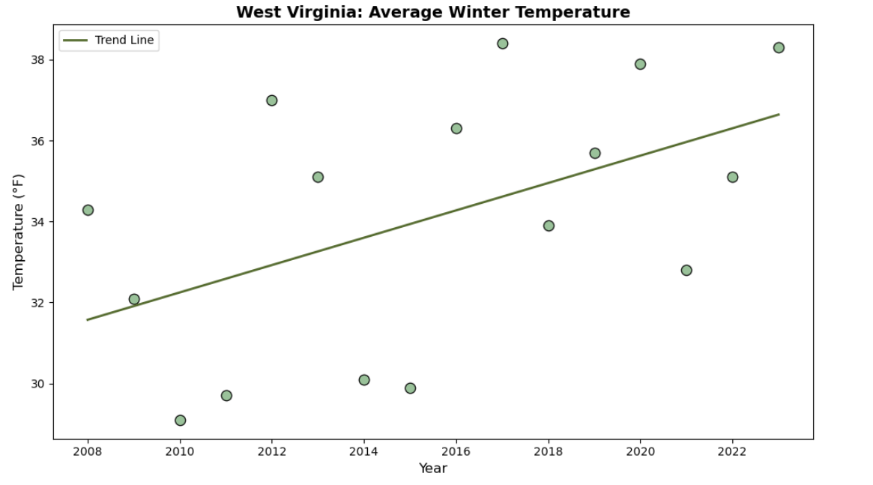
West Virginia Average Winter Temperature
Notes:
Next we’ll look at West Virginia. Average winter temperatures on the rise.

Slide 22
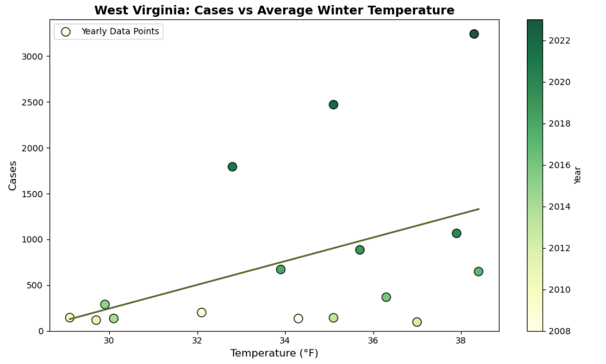
West Virginia Cases vs. Average Winter Temperature
Notes:
And as with Ohio, we’re seeing a positive relationship between winter temperatures and total cases in West Virginia. Any time temperatures go above freezing, ticks become active, so as the winters get warmer the ticks active season grows along with their potential to spread disease. States and counties that were once low case areas due to colder winters may see more cases in the future, especially in these border states right outside of the hot zones. They currently have winters hovering around freezing, but as those averages begin to move up and remain above freezing, we may see cases begin to rise, which I think we’re already starting to see here.

Slide 23
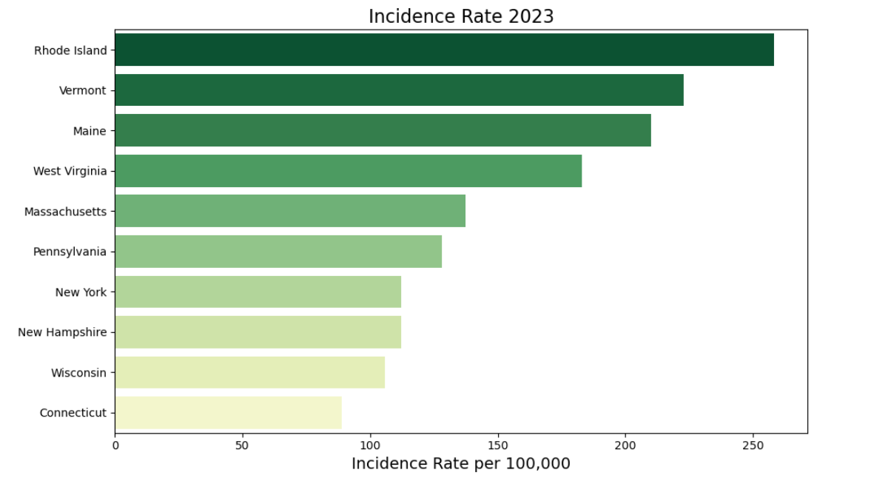
Incidence Rates 2023
Notes:
Now, up to this point, we’ve been looking at trends based on case counts. The number of cases has been growing and spreading and honestly, doesn’t look too promising. However, we need to take a step back and look at Lyme disease taking population size into account to get a real idea of risk levels. When you factor in population size to calculate the Incidence Rate for 2023, we see that it’s not New York or Pennsylvania, states with the highest case counts, that are most at risk, but actually Rhode Island. It has a rate of about 258 cases per 100,000 people. New York’s is much lower at about 112. And in fact, 6 of the Top 10 states are in New England- making it easily the most at risk region for contracting Lyme

Slide 24
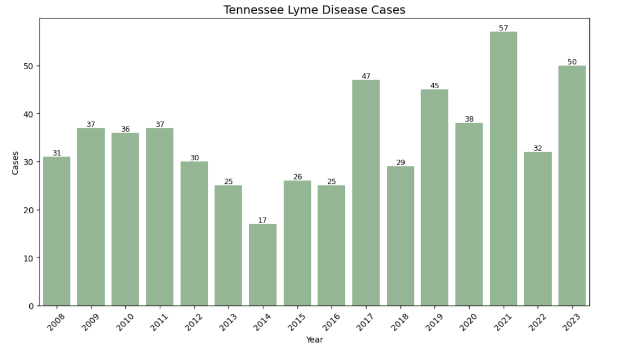
Tennessee Case Counts
Notes:
Fortunately, I live far away from there now, so I want to shift our focus to Tennessee and evaluate our risk for Lyme in Davidson County. Here we see cases across the state have been fairly low since 2008. In 2023, there were only a total of 50 cases across the entire state.

Slide 25
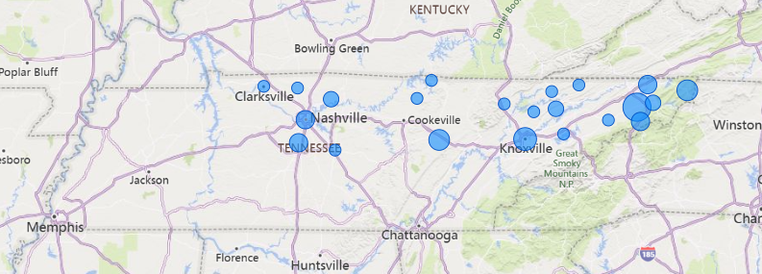
Tennessee Cases 2023
Notes:
Those 50 cases were widely distributed, but mostly in Middle and East TN.

Slide 26
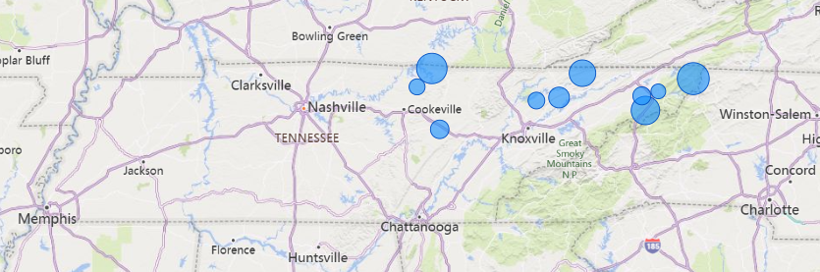
Tennessee County Incidence Rates 2023
Notes:
When we factor in population size, all of the counties with the highest incidence rates are concentrated in the northeastern portion of the state. Johnson County with the highest rate of about 22 cases per 100,000. However, it’s important to note that it only had 4 cases reported. We also notice that Davidson county has fallen off the map.

Slide 27
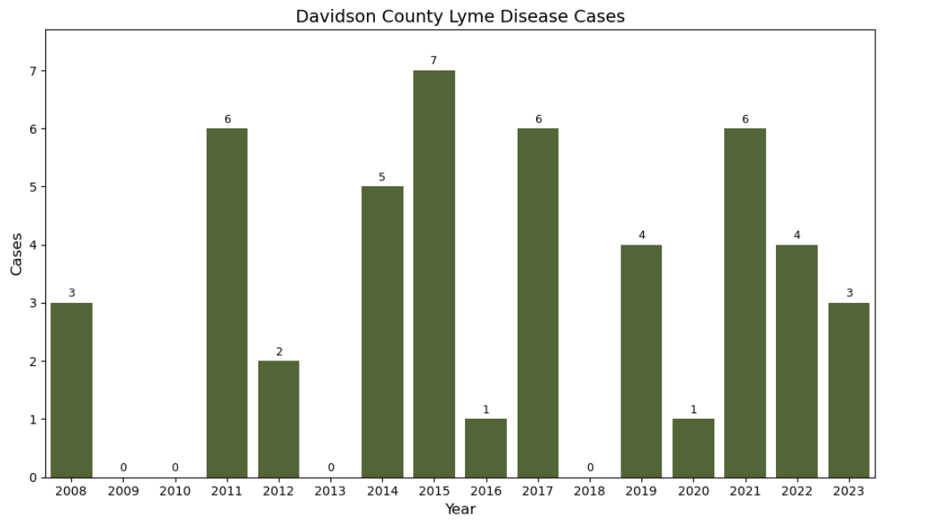
Davidson County Case Counts
Notes:
For a county with over 700,000 residents, there have been very few reported cases of Lyme. Only 3 cases in 2023, which calculates to a rate of .42 cases per 100,000 people. That is very low- almost non existent, which has come as a huge relief! I feel fairly confident that I’m not going to contract Lyme here in town at the moment, but as we saw it has been spreading and we may see more cases here in the future.

Slide 28
Opportunities for Further Analysis
Climate factors
Deer tick distribution
Behaviors and migration of host animals
Reporting
Deforestation
Urban development
Human behavior
Notes:
Doing this analysis, I have learned that climate change is just one piece of the puzzle. There are many variables when it comes to Lyme disease- all worth exploration when evaluating the risk it poses to humans.

Slide 29
Check for ticks!
Be aware of where ticks live
Wear long sleeves and long pants
Wear insect repellent
Check yourself after being outside
Notes:
But for now, I just want to thank you for your time and if you leave here only remembering one thing - don’t forget to check yourself for ticks!

